Slide 1
Breakout Session
AOR major review outcomes in detail
Rachel Wilkes, HESA (part of Jisc)
#sroc24
www.sroc.ac.uk

Slide 2
Agenda
Walk through AOR / TNE data major review proposals
Types of provision and what else was suggested in the consultation?
Discussion: how to “move” of students between the AOR record and the Student record
Other things that could affect future timelines

Slide 3
Aggregate Offshore Record

Slide 4
AOR major review – aims of the review
This review aims to address gaps in our understanding of the rapid evolution and growth of TNE
Individualised data for England and Wales
Aggregate data for Northern Ireland and Scotland
Will be collected from 2025/26 for UK partnerships, and 2026/27 for TNE data
Collected once or twice a year?
TYPE data will be given an overhaul
www.hesa.ac.uk/innovation/records/reviews/aggregate-offshore-return-review

Slide 5
AOR major review – timeline of activities
Establish priorities and identify data requirements
Develop and publish consultation materials
Complete consultation activities
Agree approach and publish consultation outcomes
Publish notification of changes for 2025/26
Publish notification of changes for 2026/27
Consider further the consultation feedback

Slide 6
AOR major review – consultation
88 responses to the consultations
UCAS sent a separate response
Non providers (7)
English Providers (64)
Welsh provider (4)
Non providers (1)
Scottish providers (13)
N. Irish providers (2)
England / Wales
Northern Ireland / Scotland

Slide 7
Why do we need a review?
England / Wales
The OfS and HEFCW state that individualised rather than aggregate data is necessary in order to better track student success. They argue that indicators and measures are required in relation to transnational education courses in order to regulate quality for students on these courses, and to ensure that positive outcomes are delivered for these students, taking into account the context in which they are studying.
The General Medical Council have a regulatory interest in detailed data on TNE for the purpose of adding these students to GMC data used for the regulation of undergraduate medical education.

Slide 8
Why do we need a review?
N Ireland / Scotland
The DfE NI and the SFC do not have a requirement for individualised data, but they are interested in improving the quality and level of detail of aggregate data collected on TNE provision.

Slide 9
What is changing?

Slide 10
CAVEATS
This is a WORK IN PROGRESS
Statutory customers have not yet signed off on this
This is the current version of the work
Blue boxes will update you on the current thinking, but this is still subject to change and further consideration by statutory customers

Slide 11
England / Wales (incl. GMC)

Slide 12
Proposal 1: Expansion to Student record coverage to collect data about partnership students
England / Wales
To include all students studying in the UK that are taught by the reporting provider or studying for an award of the reporting provider
where this provision is not already returned by another provider to HESA or to the ESFA in the ILR
Proposing new data items for these students:
Registration
Awarding body
Course delivery
Distance learning
Collect from 2025/26
New data items will not all be required yet

Slide 13
Proposal 2: Expansion to Student record coverage to collect data about TNE students
England / Wales
To include all students studying through TNE arrangements in the Student record, and cease collection of the Aggregate Offshore record
This would be a reduced data set in relation to TNE students
Collect from 2026/27
Full details not yet announced

Slide 14
Proposal 3: Changes and additions to the data model
England / Wales
Student (data futures) data model has been used as the starting point for the individualised proposal
New data items for both partnership and TNE students
New data item for TNE students (and one removed)
Existing data items (in Student record) for TNE students
Further data items for TNE students that could be submitted on an optional basis
Mostly as they were in the consultation
No optional data items will be included

Slide 15
New data items for 2025/26 – UK partnership students
England / Wales
Registration entity
Registration organisation (REGBODYID)
www.hesa.ac.uk/innovation/records/reviews/student-2025-26

Slide 16
New data items for 2026/27 – UK partnership students and TNE students
England / Wales
Registration entity
Registration organisation (REGBODYID)
Registration name (REGNAME)
Awarding body
AWARDINGBODYID
Awarding body name (AWARDINGBODYNAME)
Course role entity
Organisation name (COURSEROLENAME)
Country field (COURSEROLECOUNTRY)
Organisation name fields will not be free text – we are looking into alternative options

Slide 17
New data items for 2026/27 – UK partnership students and TNE students
England / Wales
Venue entity
Country field (VENUECOUNTRY)
Study location entity
Country field (STUDYLOCCOUNTRY)

Slide 18
New data items for 2026/27 – TNE students
England / Wales
Engagement entity
TNE flag (TNEFLAG)
Current PRINONUK field would be removed

Slide 19
England / Wales
Optional data items removed

Slide 20
Optional data items
England / Wales
The new programme type will be derived for England and Wales
 | Derive Programme type | Collect Programme type | Collect Venue type
Option 1 | Y
Option 2 | Y |  | Mandatory
Option 3 | Y |  | Optional
Option 4 |  | Mandatory | Mandatory
Option 5 |  | Optional | Optional

Slide 21
Derivation
England / Wales
Yes = reporting provider
No = another organisation
Registration | Awarding Body | CourseRole 202 Delivery Organisation | What does this mean for type of provision?
Yes (or Yes plus others) | Yes (or Yes plus others) | Yes plus others | Partnership programme
Yes | Yes | Yes | Independent programme
Yes | Yes plus others | Yes | Partnership programme
Yes | Yes | No | Franchised programme
Yes | Yes plus others | No | Franchised programme
Yes | No | Yes | Partnership programme
Yes | No | No | Franchised programme
No | Yes | No | Validated programme
No | No | Yes | Partnership programme
No | Yes | Yes | Partnership programme
No | No | No | Not returned in the record

Slide 22
Proposal 4: timing of the return
England / Wales
Once a year, covering 1 August – 31 July period
Twice a year, to fit in with the Student record timescales
the first reference period 1 August until 1 December
the second reference period 2 December until 31 July
As in-year has been delayed, no decision made on this as yet

Slide 23
Free text field amendment

Slide 24
Organisation name proposal
Reporting providers inform HESA of any new partner organisations they need to include in their return
will publish guidance on the info we need to receive (use of trading names, anglicised versions where appropriate, etc.)
Partner organisations will be available as valid entries
Will publish guidance that lists the partner organisations, including the name to be used for data returns, plus the partner’s location, any alternative names used, etc.
If there was a name change, we would update the valid entry and include the previous name in guidance
Aim to finalise the list of partner organisations shortly after the end of the reference period

Slide 25
Northern Ireland / Scotland

Slide 26
New data items
N Ireland / Scotland
Course.REGISTRATIONSTATUS with valid entries:
Registered and awarding qualification
Registered
Awarding qualification)
Course.DELIVERYSTATUS with valid entries:
Delivering all of the teaching
Delivering some of the teaching
Considering collecting who is delivering the course (when not the reporting provider)

Slide 27
New data items
N Ireland / Scotland
Provision entity:
# of students continuing study (HEADCOUNTSCS)
# of students successfully completed (HEADCOUNTSSC)
# of students starting study (HEADCOUNTSSS)
Venue name (VENUENAME)
New Course entity created
New Qualification subject entity with fields:
Subject of the qualification (QUALSUBJECT)
Proportion allocated to each subject contributing to the qualification (QUALPROPORTION)

Slide 28
New data items
N Ireland / Scotland
Considering defining distance learning as only applicable at the start of the course
(so if it changes, don’t need to update)
Provision.VENUETYPE with valid entries:
International branch campus
Joint venture
Partner campus
Distance learning
Course.PROGRAMMETYPE with valid entries:
Independent programme
Partnership programme
Franchised programme
Validated programme

Slide 29
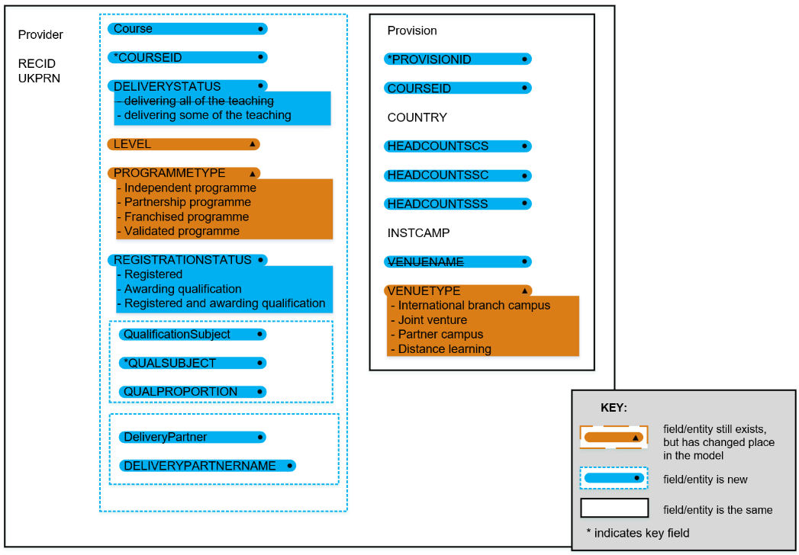
N Ireland / Scotland

Slide 30
Wrapping up questions
N Ireland / Scotland
Preferred method of collecting TNE data
Continue with the Aggregate Offshore record
Combine with the Student record
Timing of the return
Once a year (covering 1 August – 31 July period)
Twice a year (to fit in with the Student record timescales)
Continue with collecting in AOR only…
… therefore, collect only once a year

Slide 31
Replacement for TYPE field

Slide 32
Replacement for identifying the types
Started with the British Council classification framework for international programme and provider mobility from 2017
Drawn out scenarios to explain our definitions
Consultation asks whether we have identified all the variety of provision at providers – are there any others?
Providers in NI and S: two new fields in AOR for programme type and venue type
Providers in E and W: options to consider for Student
Northern Ireland and Scotland will collect two fields in AOR
England and Wales will use a derivation in Student

Slide 33
Replacement for identifying the types
Programme types:
Independent programme
Partnership programme
Franchised programme
Validated programme
Venue types:
International branch campus
Joint venture
Partner campus
Distance learning

Slide 34
Other provision from the consultation
Programme type definitions / derivations
Partnership programme involving multiple UK (or overseas) providers
Dual / double / multiple / joint awards
Joint supervision on overseas PhDs
Articulation, top-up, and twinning arrangements
Franchise arrangements where the overseas provider registers the student and validation arrangements where the UK provider registers the student
Full versus joint franchise / validation arrangements
FHEQ versus RQF: capturing accrediting as well as awarding bodies
Flying faculty arrangements

Slide 35
Other provision from the consultation
Venue type and distance learning definitions
Blended learning: majority distance learning with a minority proportion of in-person learning at an overseas location
Blended learning: majority distance learning with a minority proportion of in-person learning at a UK location
Blended learning: UK provider delivers distance learning materials and students may attend a local site (perhaps but not necessarily a “partner”) for instruction or other support

Slide 36
Other provision from the consultation
Proposed scenario additions
Partnership programme involving more than two providers
Joint degree programme ?
Double degree programme ?
Joint supervision on overseas PhDs
Partnership programme at a partner campus (flying faculty) ?
Independent programme at own campus (with distance learning) ?
Independent programme at partner campus (with distance learning) ?
Independent programme at non-partner campus (with distance learning) ?

Slide 37
Any questions on AOR review content?

Slide 38
Workshop – moving between records

Slide 39
Current rules – AOR coverage
In general, the Aggregate Offshore record should be collected in respect of students studying (to date) wholly outside the UK who are either registered with the reporting provider and aiming for a qualification or credit, or who are studying for an award of the reporting provider.
Providers in England should only include validated provision where it is not included in the Aggregate Offshore record of another provider registered with the Office for Students.

Slide 40
Current rules – Student coverage
If it is known at the beginning of the engagement that a student will spend a block of eight weeks or more in the UK as part of their engagement then they should be included on the HESA Student record throughout.
>8 weeks

Slide 41
Current rules – Student coverage
If a period of eight weeks or more in the UK is an optional part of the course the student is engaging with, then the student should be included in the HESA Student record only if they come to the UK, and then from that point at which they come to the UK onwards.
Optional
>8 weeks

Slide 42
Current rules – Student coverage
If a student is expected to spend less than eight consecutive course weeks in the UK during their entire engagement they should be included on the Aggregate offshore record throughout.
<8 weeks

Slide 43
General (simplified) principles
In the current process, once a student has been included within the Student return, they cannot then move to AOR, even if they move to continue their studies outside the UK. They must continue to be returned in the Student return for the remainder of their Engagement.
There are some cases where the student intends to spend the entirety of their studies outside the UK, and so is included within the AOR return, but subsequently moves to the UK. In these cases, the student would be included within the Student return from that point.

Slide 44
Examples – student A
Student A spends their first year in the UK and so is included in the Student return
After this point they move to continue their studies outside the UK
As they spend their first year in the UK, they must continue to be included within the Student return even if they spend the remainder of their studies outside the UK

Slide 45
Examples – student B
Student B is expected to spend their entire studies outside the UK and so are included in the AOR return
After 2 years their circumstances change, and they move to the UK to complete their studies
Student will then move to be included in the Student return as they will now be spending more than 8 weeks in the UK (start date would reflect the date they started their activity outside the UK)

Slide 46
Examples – student C
Student C is expected to spend 10 weeks during their course in the UK and so is included in the Student return
They must continue in the Student return, even for the periods of time they spend outside of the UK

Slide 47
Options for consideration today
What if we allowed students to move back to the lower level of data (AOR or TNE level in Student)?
Would returning a lower amount of data be helpful to providers, or more work?
How would we define the scenarios where this is allowed?
Use the TNE data flag in Student?

Slide 48
Examples – student A (to consider)
Student A spends their first year in the UK and so is included in Student
After this point they move to continue their studies outside the UK
Student could be allowed to move to AOR / the reduced TNE level of data

Slide 49
Examples – student B (to consider)
Student B is expected to spend their entire studies outside the UK and so are included in the AOR return / TNE level of data
After 2 years their circumstances change, and they move to the UK to complete their studies
Student will then move to be included in the Student return as they will now be spending more than 8 weeks in the UK (start date would reflect the date they started their activity outside the UK)

Slide 50
Examples – student C (to consider)
Student C is expected to spend 10 weeks during their course in the UK and so is included in the Student return
Student should be in the Student return for the periods of time they are in the UK
Student could be allowed to move to AOR / the reduced TNE level of data for the periods of time they are outside of the UK

Slide 51
Discuss in groups:
Would you like to return a lower level of data when students are not in the UK?
Can you see any difficulties with requirements shifting back and forth?
Are the scenarios clear for when students would move between the different levels of data?
What is the best way to identify these students? Is the TNE flag enough?

Slide 52
Questions to audience members
We would like to run a session open to all providers on this. What is the most appropriate forum to do that?
Formal consultation
Workshop
Online event

Slide 53
Things affecting future timelines

Slide 54
2023/24
Another annual Student collection
Another AOR collection
GMC spreadsheet return using standardised template
www.hesa.ac.uk/innovation/records/reviews/student-2023-24
www.hesa.ac.uk/innovation/records/reviews/aggregate-offshore-2023-24

Slide 55
2024/25
Another annual Student collection
Another AOR collection
2024/25: first potential collection of GMC Assessment data within Data Futures – THIS IS NOT HAPPENING
www.hesa.ac.uk/innovation/records/reviews/student-2024-25

Slide 56
2025/26
No more ITT returns
Another annual Student collection
Another AOR collection
Expansion to Student record coverage to include UK partnership students (plus registration details)
www.hesa.ac.uk/innovation/records/reviews/student-2025-26

Slide 57
2026/27
First possible in-year return?
Expansion to Student record coverage to include TNE students for providers in England and Wales
Expansion to AOR for providers in Northern Ireland and Scotland
Data collected for LLE?
Staff record review outcomes implemented
www.hesa.ac.uk/news/23-11-2023/aor-consultation-initial-outcomes
www.hesa.ac.uk/news/14-03-2024/independent-review-in-year-student-record

Slide 58
First possible in-year return?
There will be two reference periods
Reference period one: 1 August - 1 December
Reference period two: 2 December - 31 July

Slide 59
Staff record review – themes
1) Coverage of the record
Non-academic (or professional services) staff
Staff working for wholly owned subsidiary companies
2) Careers in HE
Career stages and employment conditions
Progression and longitudinal tracking
Porosity of the sector
3) Staff activities and employment functions
Research activity and the REF
Blurred line between academic and non-academic staff
Involvement in KE
4) Staff demographics
Pay gaps (gender and intersectional)
Comparison of academic and non-academic staff
Nationality and immigration issues

Slide 60
Any questions?

Slide 61
We hope you have enjoyed this session and we value your feedback, please take the time to rate this session in the conference app. You can find a guide in the app FAQs. Coming up next: Refreshments in the Esther Simpson Cafe
#sroc24
www.sroc.ac.uk

